Slide 1
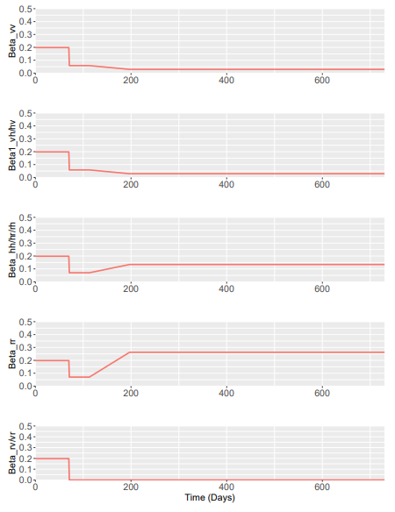
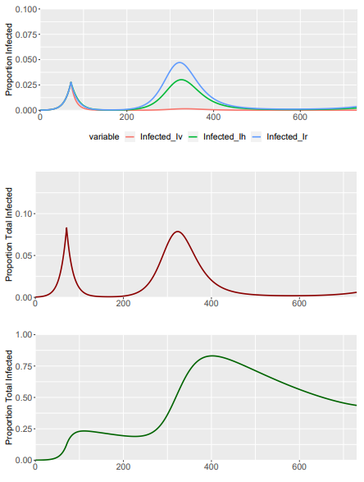
Baseline Model – NO INFLATION – DELTA = 1
 | Vulnerable | Shielders | Remainders
Vulnerable | β₁ | β₁ | β₄δ
Shielders | β₁ | β₂ | β₂
Non-Vulnerable | β₄δ | β₂ | β₃
 | Vulnerable | Shielders | Remainders
Vulnerable | 0.198 | 0.198 | 0.198
Shielders | 0.198 | 0.198 | 0.198
Non-Vulnerable | 0.198 | 0.198 | 0.198
Phase 0

Slide 2
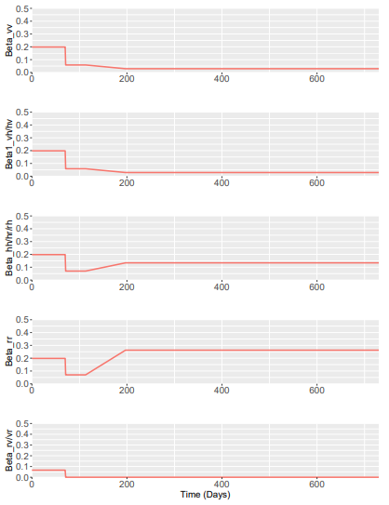
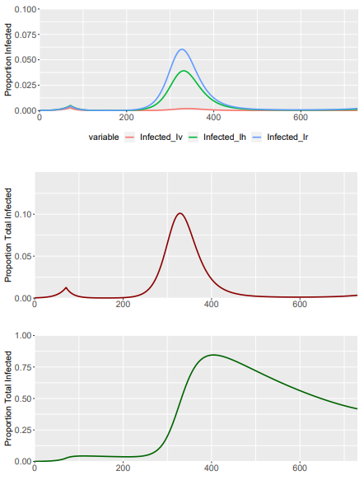
Baseline Model – NO INFLATION – DELTA = 0.333
 | Vulnerable | Shielders | Remainders
Vulnerable | β₁ | β₁ | β₄δ
Shielders | β₁ | β₂ | β₂
Non-Vulnerable | β₄δ | β₂ | β₃
 | Vulnerable | Shielders | Remainders
Vulnerable | 0.198 | 0.198 | 0.066
Shielders | 0.198 | 0.198 | 0.198
Non-Vulnerable | 0.066 | 0.198 | 0.198
Phase 0

Slide 3
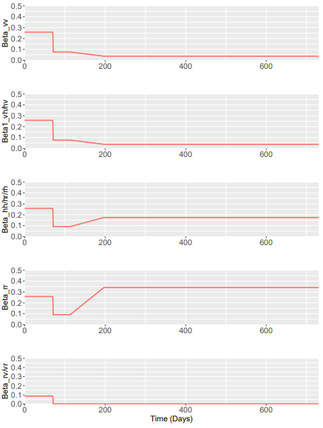
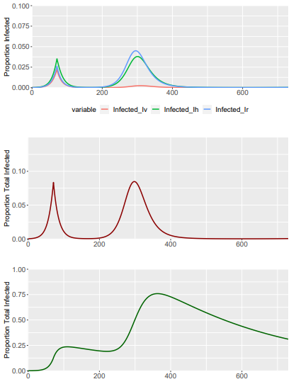
Baseline Model – SIGMA PARAMETER– DELTA = 0.33
Sigma = 1.3 – To roughly match the same Inf_tot and Recov_tot profile as baseline
 | Vulnerable | Shielders | Remainders
Vulnerable | β₁σ | β₁σ | β₄δσ
Shielders | β₁σ | β₂σ | β₂σ
Non-Vulnerable | β₄δσ | β₂σ | β₃σ
 | Vulnerable | Shielders | Remainders
Vulnerable | 0.258 | 0.258 | 0.086
Shielders | 0.258 | 0.258 | 0.258
Non-Vulnerable | 0.086 | 0.258 | 0.258
Phase 0

